Slide 1
UNIT II – TOPOLOGIES,NETWORK HARDWARE AND SOFTWARE
COMPUTER NETWORKS I
CODE: CS 8137
FACILITATOR: FRANK
EMAIL: frankibrahim25@gmail.com

Slide 2
Network Topologies
Network topology is the arrangement of the various elements (links, nodes, etc.) of a computer network.
Essentially, it is the topological structure of a network, and may be depicted physically or logically
Physical topology refers to the placement of the network's various components, including device location and cable installation
Logical topology shows how data flows within a network, regardless of its physical design.

Slide 3
Physical Topology
Mesh topology
A mesh topology is the one where every node is connected to every other node in the network.
A mesh topology can be a full mesh topology or a partially connected mesh topology.
In a full mesh topology, every computer in the network has a connection to each of the other computers in that network.
The number of connections in this network can be calculated using the following formula (n is the number of computers in the network):
n(n-1)/2

Slide 4
In a partially connected mesh topology, at least two of the computers in the network have connections to multiple other computers in that network.
In the event that one of the primary computers or connections in the network fails, the rest of the network continues to operate normally.
Advantages of mesh topology
Eliminate the traffic problems: The use of dedicated links guarantees that each connection can carry its own data load.
A mesh topology is robust. If one link becomes unusable, it does not incapacitate the entire system

Slide 5
There is the advantage of privacy or security. When every message travels along a dedicated line, only the intended recipient sees it.
Disadvantage of mesh topology
The main disadvantages of a mesh are related to the amount of cabling and the number of I/O ports required.
Because every device must be connected to every other device, installation and reconnection are difficult.
The sheer bulk of the wiring can be greater than the available space (in walls, ceilings, or floors) can accommodate.

Slide 6
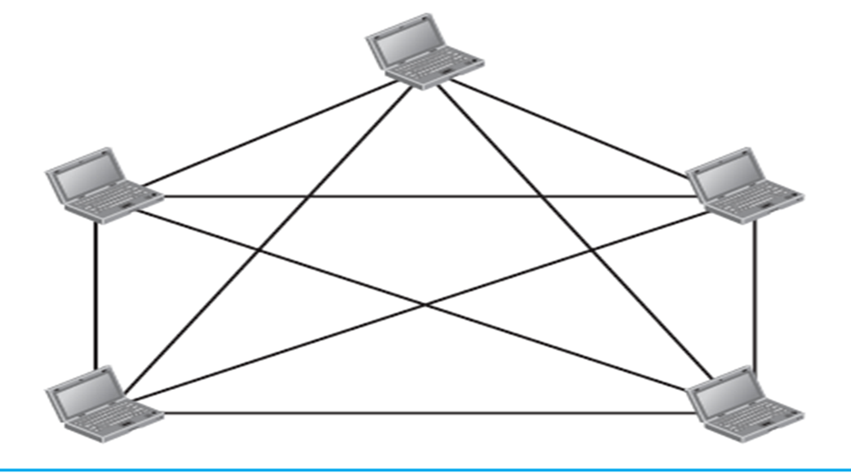
Mesh topology

Slide 7
Star Topology
In a star topology, each device has a dedicated point-to-point link only to a central controller, usually called a hub. The devices are not directly linked to one another.
Unlike a mesh topology, a star topology does not allow direct traffic between devices. The controller acts as an exchange.
If one device wants to send data to another, it sends the data to the controller, which then relays the data to the other connected device.

Slide 8
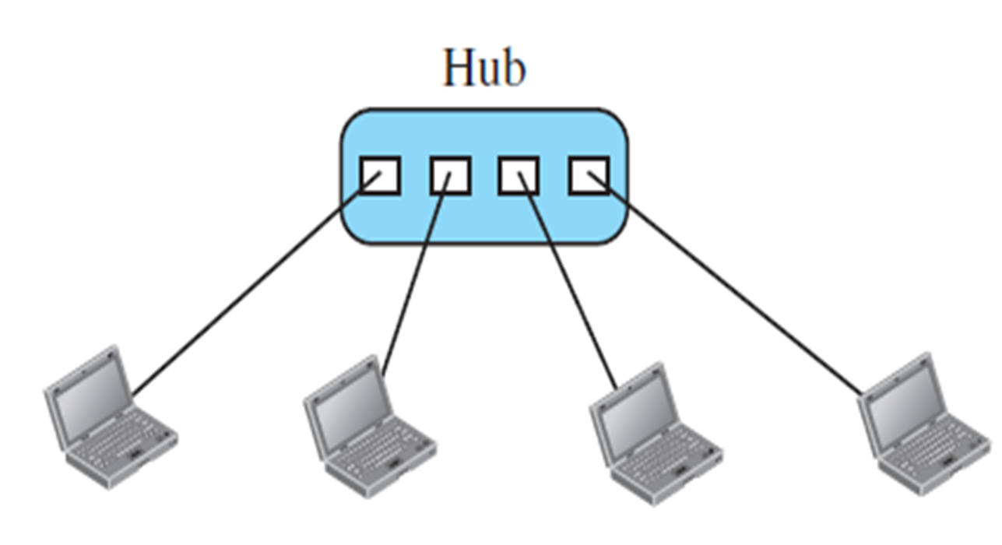
Star topology

Slide 9
Advantage of star topology
A star topology is less expensive than a mesh topology. In a star, each device needs only one link and one I/O port to connect it to any number of others.
Robustness. If one link fails, only that link is affected. All other links remain active. This factor also lends itself to easy fault identification and fault isolation.
Disadvantage of star topology
One big disadvantage of a star topology is the dependency of the whole topology on one single point, the hub. If the hub goes down, the whole system is dead.

Slide 10
Bus Topology
A bus topology is a network setup in which each computer and network device are connected to a single cable or backbone.
Nodes are connected to the bus cable by drop lines and taps.
A drop line is a connection running between the device and the main cable.
A tap is a connector that either splices into the main cable or punctures the sheathing of a cable to create a contact with the metallic core.

Slide 11
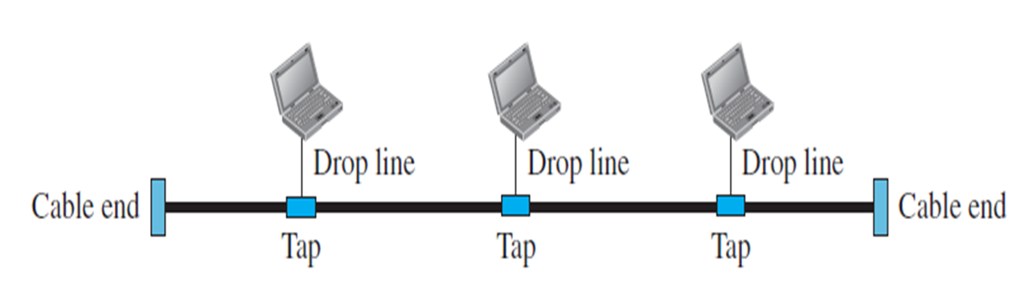
Advantages of a bus topology
Ease of installation. Backbone cable can be laid along the most efficient path, then connected to the nodes by drop lines of various lengths.
Disadvantages of a bus topology
Difficult reconnection and fault isolation. A bus is usually designed to be optimally efficient at installation. It can therefore be difficult to add new devices.

Slide 12
Ring Topology
In a ring topology, each device has a dedicated point-to-point connection with only the two devices on either side of it.
A signal is passed along the ring in one direction, from device to device, until it reaches its destination. Each device in the ring incorporates a repeater.
When a device receives a signal intended for another device, its repeater regenerates the bits and passes them along.
A ring is relatively easy to install and reconfigure. Each device is linked to only its immediate neighbors (either physically or logically).

Slide 13
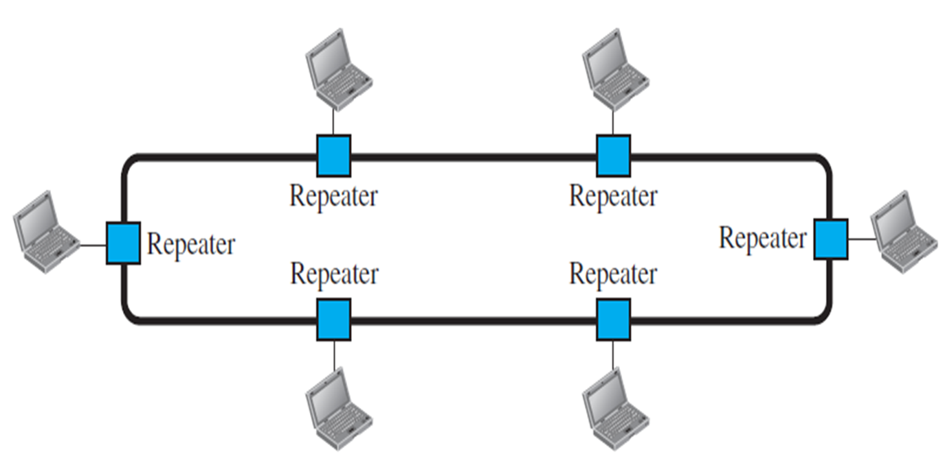
A ring topology connecting six stations

Slide 14
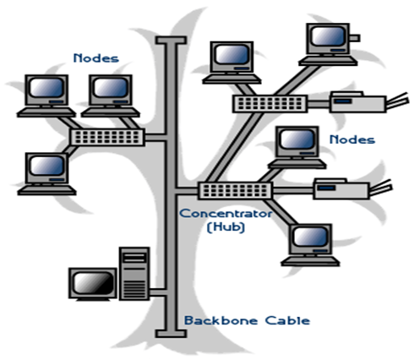
Tree or Expanded Star
A tree topology combines characteristics of linear bus and star topologies.
It consists of groups of star-configured workstations connected to a linear bus backbone cable (See fig. below).
Tree topologies allow for the expansion of an existing network, and enable schools to configure a network to meet their needs.

Slide 15
5-4-3 Rule
A consideration in setting up a tree topology using Ethernet protocol is the 5-4-3 rule.
One aspect of the Ethernet protocol requires that a signal sent out on the network cable reach every part of the network within a specified length of time.
Each concentrator or repeater that a signal goes through adds a small amount of time.
This leads to the rule that between any two nodes on the network there can only be a maximum of 5 segments, connected through 4 repeaters/concentrators and only 3 of the segments may be populated (trunk) segments if they are made of coaxial cable.

Slide 16
A populated segment is one that has one or more nodes attached to it.
NOTE: This rule does not apply to other network protocols or Ethernet networks where all fiber optic cabling or a combination of a fiber backbone with UTP cabling is used. If there is a combination of fiber optic backbone and UTP cabling, the rule would translate to a 7-6-5 rule.

Slide 17
There is considerable confusion in the literature between a computer network and a distributed system.
In a Distributed system, the existence of multiple autonomous computers is transparent(i.e., not visible) to the user.
The user of a distributed system is not aware of that there are multiple processors; it looks like a virtual uniprocessor.
With a network, users must explicitly log onto one machine, explicitly submit jobs remotely, explicitly move files around and generally handle all the network management personally.

Slide 18
The distinction between Network and distributed system lies with software (OS) rather than software.
In network user invokes, in distributed system the system invokes.
NETWORK HARDWARE AND SOFTWARE

Slide 19
Introduction
When we refer to network hardware we are talking about range of electronic devices that can be interconnected in such a way that to allow the transmission of communication signals between a number of workstation.
These devices rage from electronic devices to sophisticated proprietary hardware such as routers and gateways.
Computer networks components comprise both physical parts as well as the software required for installing computer networks, both at organizations and at home.

Slide 20
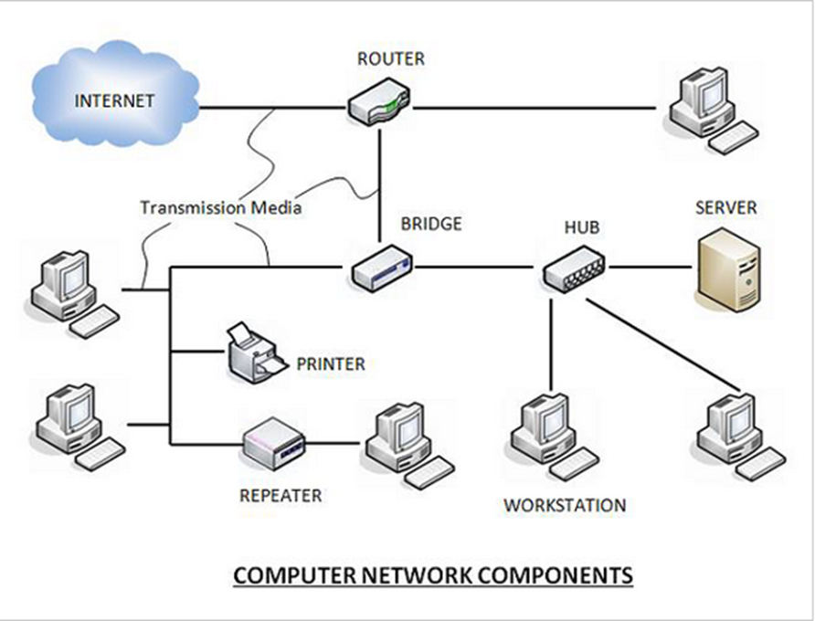
The hardware components are the server, client, peer, transmission medium, and connecting devices. The software components are operating system and protocols.

Slide 21
Hardware Components
Servers: Servers are high-configuration computers that manage the resources of the network.
The network operating system is typically installed in the server and so they give user accesses to the network resources.
Servers can be of various kinds: file servers, database servers, print servers etc.
Clients: Clients are computers that request and receive service from the servers to access and use the network resources.
Peers: Peers are computers that provide as well as receive services from other peers in a workgroup network.

Slide 22
Transmission Media: Transmission media are the channels through which data is transferred from one device to another in a network.
Transmission media may be guided media like coaxial cable, fiber optic cables etc; or maybe unguided media like microwaves, infra-red waves etc.
Connecting Devices: Connecting devices act as middleware between networks or computers, by binding the network media together.
Some of the common connecting devices are:

Slide 23
NIC (Network Interface cards)
NIC cards are hardware components used to connect computers with networks. Without NIC a computer cannot be connected to the network
It is a circuit board installed in a computer that provides a dedicated network connection to the computer.
It is also called network interface controller, network adapter or LAN adapter.
Using unique hardware addresses (MAC address) encoded on the card chip, the data-link protocol employs these addresses to discover other systems on the network so that it can transfer data to the right destination.

Slide 24
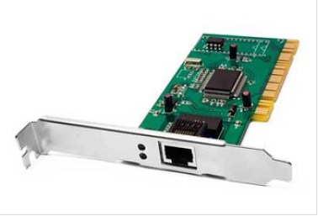
Types of NIC
Wired NIC: In wired NIC, the motherboard has a slot for the network card where it can be inserted.
The wired NIC uses cables and connectors as a medium to transfer data.
Wireless NIC: The wireless NIC contains the antenna to obtain the connection over the wireless network. For example, laptop computer contains the wireless NIC.

Slide 25
HUB
Hub is a device that splits a network connection into multiple computers. It is like a distribution center. When a computer request information from a network or a specific computer, it sends the request to the hub through a cable.
The hub will receive the request and transmit it to the entire network.
After that, every computer checks whether that network then belongs to them or not. If belongs then it broadcasts if the request doesn’t belong it will be dropped.

Slide 26
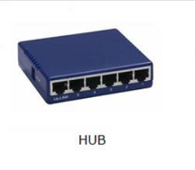
The process used by the Hub consumes more bandwidth and limits the amount of communication.
Nowadays, the use of hub is obsolete, and it is replaced by more advanced computer network components such as Switches, Routers.

Slide 27
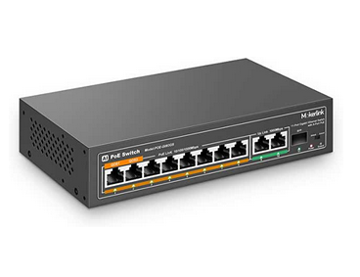
Switches
Switches look nearly identical to hubs but a switch has more advanced features than a hub. It doesn’t broadcast entire data on the network like a hub.
A switch is a hardware device that connects multiple devices on a computer network.
The advanced features of the switch imply that the network switch first inspects the incoming packet and determines its source, destination address, and routes after that sends the data at the correct destination accordingly to that packet.

Slide 28
Bridges
This bridge is a device that has such functionality that it filters the content, for which it reads MAC addresses of both source and destination.
The bridge connects two LANs (Local Area Network) using the same protocol. This device operates in the data link layer of the OSI Model.
These network components are very useful for filtering the data load of traffic, for which they divide them into segments or packets.
The bridge controls the data traffic of LANs or other networks. These bridges are actually passive devices, as there is no interaction between bridged and paths of bridging.

Slide 29
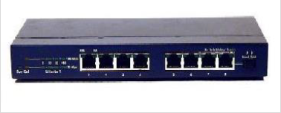
Repeater
A repeater is a powerful network component that is used to regenerate signals. With this, the signal is fixed for a long time, so that the strength of the signal remains stable.
Repeater takes data signals from the communication medium and amplifies them and sends them back to the communication medium.

Slide 30
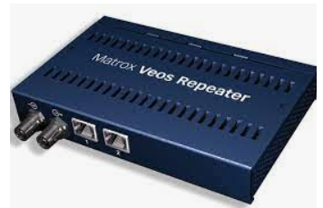
When the signal becomes weak, this device copies the signal bit by bit and then regenerates it to its original strength for making the internet connection stable.
A repeater is located in the first layer (physical layer) of the OSI layer. Repeaters are used in cables that have to cover distances of up to 100 meters. These components receive signals from cables like optical fibers, coaxial cables, and copper cables.

Slide 31
Router
A router is a hardware device which is used to connect a LAN with an internet connection. It is used to receive, analyze and forward the incoming packets to another network.
A router works in a Layer 3 (Network layer) of the OSI Reference model.
A router forwards the packet based on the information available in the routing table.
It determines the best path from the available paths for the transmission of the packet.

Slide 32
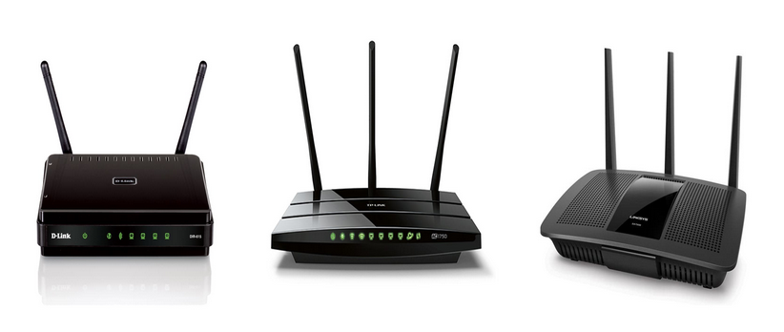
Gateway
This gateway is a hardware device that acts as a “gate” within two networks. It can also be a router, firewall, server, or any other device that enables traffic to flow in and out of the network.
Gateways are used to connect networks based on different protocols. As a bridge is used to join two similar types of networks, similarly, the gateway is used to join two dissimilar networks.

Slide 33
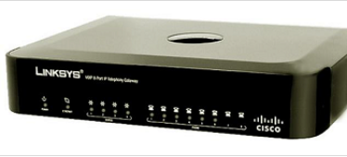
This gateway node is located at the edge of the network and all the data flows through it which enters or exits the network.
In addition, it can also translate received data that is received from outside networks, into a format or protocol that can be identified by devices within the internal network.

Slide 34
Modem
A modem is a hardware device that allows the computer to connect to the internet over the existing telephone line.
A modem is not integrated with the motherboard rather than it is installed on the PCI slot found on the motherboard.
It stands for Modulator/Demodulator. It converts the digital data into an analog signal over the telephone lines.
Based on the differences in speed and transmission rate, a modem can be classified in the following categories:
Standard PC modem or Dial-up modem
Cellular Modem
Cable modem

Slide 35
Network Software
Protocol Hierarchies: To reduce their design complexity, most networks are organized as a stack of layers or levels, each one built upon the one below it.
The number of layers, the name of each layer, the contents of each layer, and the function of each layer differ from network to network.
The purpose of each layer is to offer certain services to the higher layers, shielding those layers from the details of how the offered services.

Slide 36
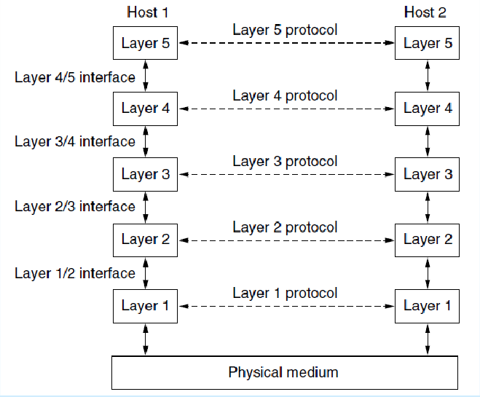

Slide 37
Connection-Oriented and Connectionless Services
Layers can offer two different types of service to the layers above them: connection-oriented and connectionless.
Connection-Oriented: a connection-oriented network service, the service user first establishes a connection, uses the connection, and then releases the connection.
Connectionless service is modeled after the postal system. Each message (letter) carries the full destination address, and each one is routed through the system independent of all the others. Normally, when two messages are sent to the same destination, the first one sent will be the first one to arrive.

